Slide 1
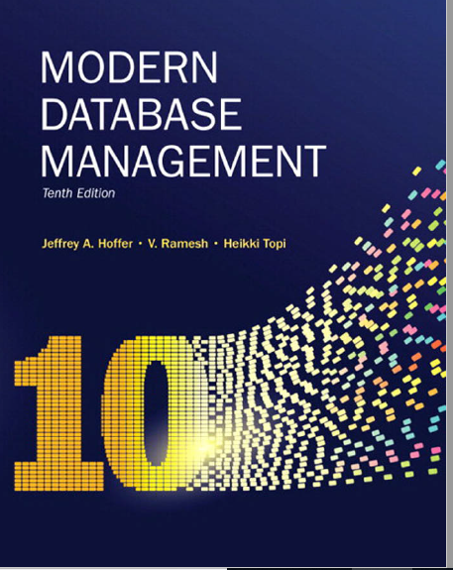
Chapter 7 Review
Multiple Table Processing
- Subquery -

Slide 2

Processing Multiple Tables Using Subqueries
Subquery–placing an inner query (SELECT statement) inside an outer query
Options:
In a condition of the WHERE clause
As a “table” of the FROM clause
Within the HAVING clause
In the SELECT clause
Subqueries can be:
Noncorrelated–executed once for the entire outer query
Correlated–executed once for each row returned by the outer query
Notes:
We covered using join to process multiple tables. Another way is through use of subqueries.
Subquery is as the name suggests a query within the query.
Subquery can be placed in “
SELECT clause
FROM Caluse
HAVING clause
Two types:
Correlated – needs a link between the outer query and the subquery -> executes for each row returned in the query
Non-correlated – there is on inner link in the subquery. Executes once

Slide 3
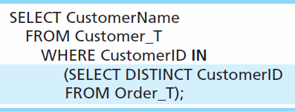
Subquery Example
Show all customers who have placed an order
The IN operator will test to see if the CUSTOMER_ID value of a row is included in the list returned from the subquery
Subquery is embedded in parentheses. In this case it returns a list that will be used in the WHERE clause of the outer query
Notes:
Subquery is what is in parenthesis.
In this example, the subquery can run by itself and return a result. Subquery is always in parenthesis
The subquery will return a list of all distinct or unique customer ID, and then that result is used to filter the outer query
This is a non-correlated subquery

Slide 4

Correlated vs. Noncorrelated Subqueries
Noncorrelated subqueries:
Do not depend on data from the outer query
Execute once for the entire outer query
Correlated subqueries:
Make use of data from the outer query
Execute once for each row of the outer query
Can use the EXISTS operator
Notes:
Noncorrelated subqueries:
Do not depend on data from the outer query – just like we saw in the prior example the subquery could run by itself and you will see a list of customer ids
Execute once for the entire outer query – only executves
Correlated subqueries:
Make use of data from the outer query
Execute once for each row of the outer query

Slide 5
Correlated Subquery Example
Show all orders that include furniture finished in natural ash
SELECT DISTINCT OrderID FROM OrderLine o
WHERE EXISTS
(SELECT * FROM Product p
WHERE p.ProductID = o.ProductID
AND Productfinish = ‘Natural ash’);
The EXISTS operator will return a TRUE value if the subquery resulted in a non-empty set, otherwise it returns a FALSE
The subquery is testing for a value that comes from the outer query
➔ A correlated subquery always refers to an attribute from a table referenced in the outer query
Notes:
Co-related meaning the attributes of the inner is related to the attribute of the
Matching fields from the outer query with fields from the subquery

Slide 6
Tips for Developing Queries
Be familiar with the data model (entities and relationships)
Understand the desired results
Know the attributes desired in result
Identify the entities that contain desired attributes
Review ERD
Fine tune with GROUP BY and HAVING clauses if needed
Consider the effect on unusual data

Slide 7
Query Efficiency Considerations
Instead of SELECT *, identify the specific attributes in the SELECT clause; this helps reduce network traffic of result set
Limit the number of subqueries; try to make everything done in a single query if possible
If data is to be used many times, make a separate query and store its results rather than performing the query repeatedly

Slide 8
Guidelines for Better Query Design
Understand how indexes are used in query processing
Keep optimizer statistics up-to-date
Use compatible data types for fields and literals
Write simple queries
Break complex queries into multiple simple parts
Don’t nest one query inside another query
Don’t combine a query with itself (if possible avoid self-joins)

Slide 9
Sub-Query Exercise
Notes:
SELECT e.emp_fname, e.emp_lname, w.job
FROM employee e left join works_on w on e.emp_no = w.emp_no

Slide 10
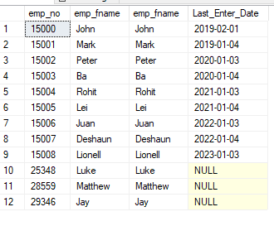
Problem 1
Write a SQL query to return all employee names (first and last), and the last “enter date” of projects they worked on.
Notes:
/*scorrelated subquery approach*/
select e.emp_no, e.emp_fname, e.emp_lname,
( select
max(w.enter_date) from works_on w
where w.emp_no = e.emp_no) As Last_Enter_Date
from employee e
/* JOIN*/
select e.emp_no, e.emp_fname, e.emp_lname,
max(w.enter_date) as LastEnter_Date
from employee e
LEFT JOIN works_on w on e.emp_no = w.emp_no
group by e.emp_no, e.emp_fname, e.emp_lname
/* using join subquery in the from clause*/
select e.emp_no, e.emp_fname, e.emp_fname, p.Last_Enter_Date
from employee e left join
(select w.emp_no, max(w.enter_date) Last_Enter_Date from [works_on] w
group by w.emp_no ) as p
on e.emp_no = p.emp_no

Slide 11
Problem 2
Write a SQL query to return only employee names (first and last) that worked on project with the word “system” in the description, and budget over $130,000
Notes:
select *
from employee e
where exists
(select 1
from works_on w
join project p on w.project_no =p.project_no
where w.emp_no= e.emp_no
and p.project_name like '%system%'
and budget>130000
)

